Slide 1
Generic Data Leakage Detection in AWS Cloud Platform
Project Name: G-DLD

Slide 2
Data Leakage Introduction
Data leakage is a common problem in databases.
It can lead to reputational damage, legal consequences, and financial losses.
So far, there is only best-practice for prevention.
Data Leakage could be manifested as in various ways.
Notes:
Data leakage is a common problem in databases and cloud applications, that involves data from a private source getting exposed.
It is a significant concern for organizations that rely on serverless computing as it can lead to reputational damage, legal consequences, and financial losses.
So far, there is no real solution for detection, only best-practice for prevention.
Data Leakage could be manifested as data breaches, data exfiltration or generic data being misplaced.

Slide 3
Research Question
Can we detect data leakage generically in serverless applications?
How much log data it would take to discover a data leakage if such event happens?
What are the signs of data leakage in serverless application?
Where should we look for the trails of a leakage?
What are the generic data points that are similar for data leakage attacks?

Slide 4
Hypothesis
Our hypothesis is that permission and storage combined logs may discover data leakage attempts and leaks that has weak trails in the system.

Slide 5










GDLD Overview
An example for the proposed attack with the examined property value ‘male’.
Phase 1
Phase 2
Phase 3
Phase 4
Dataset 1
Substitute model M1
Benign Samples
Adversarial Samples
Adversarial samples that mislead substitute M1
and not substitute M2
% of success
Target Model
100% Male
85%
Adversarial samples that mislead both models
Male is selected
Dataset 2
Substitute model M2
Adversarial samples that mislead substitute M2
and not substitute M1
% of success
65%
100% Female
Induce two substitute models with and without the examined property value
Craft adversarial samples to attack each of the substitute models
Filter the unique adversarial samples for each substitute model
Query the target model to learn the relative success of each set

Slide 6
Model Features
The features being used.
targetType | operationUsed
String Features
readOnly | Change_s3 | Change_DynamoDB | Remove_policy | anomaly
Numeric Features

Slide 7
Model Architecture
The method is using unsupervised methodology to solve for generic .
15,482 rows
Train 6,563 rows
Test 1,641 rows
Encode categorical
Benign
Train
Label Encoder
Test
contamination-=0.01 (serves as threshold)
Returns Range between -1 to non-negative
Returns 0/1
Fit
Unsupervised Model
Decision Function
Train
Predictions
Predictions
Test
Predict

Slide 8
Weekly Research Status

Slide 9
Previous Status Meeting Tasks 14.08.2023
Feature testing Results with new data.

Slide 10
Update 13.11.2023
Logs review.
.

Slide 11
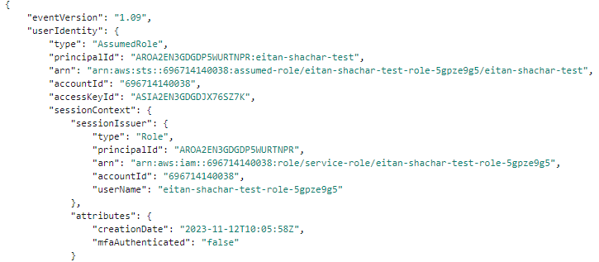
Logs Review

Slide 12
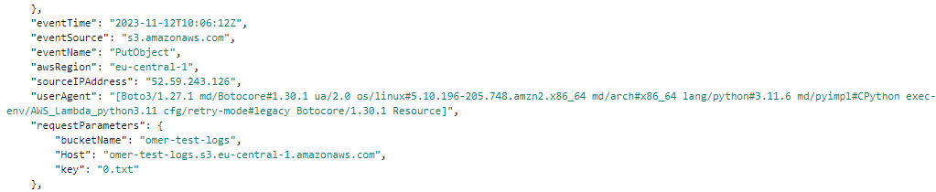
Logs Review

Slide 13
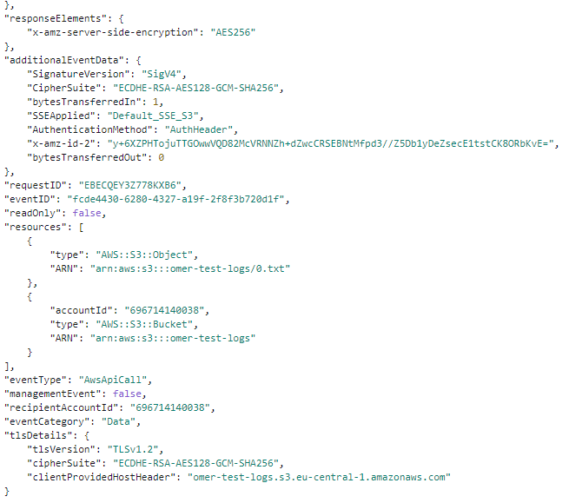
Logs Review

Slide 14
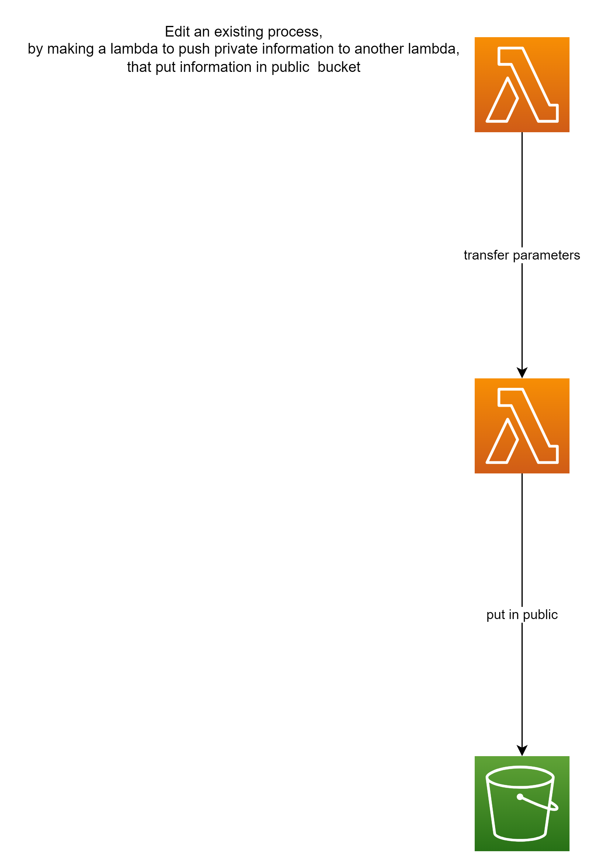
New Attack - Parameter Inflating
A lambda in the flow is hijacking private data from parameters.
The next lambda will deposit the data in a storage.
This attack will be unnoticeable through regular logging of the lambda.
Information will not be visible with the use of unprintable characters.
1
Parameters +
1
Parameters +
2
2

Slide 15
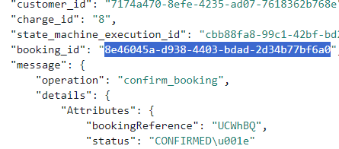
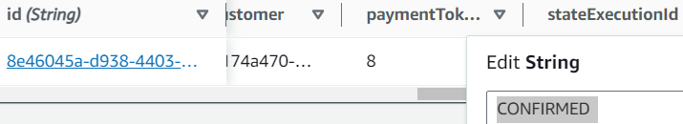
New Attack - Parameter Inflating
The attack targeted the status string.
It now contains the ASCII character that is used to represent a number in our attack.
An attacker may reassemble the data in this way.

Slide 16
Update 26.09.2023
New attacks.
Results with new data.

Slide 17
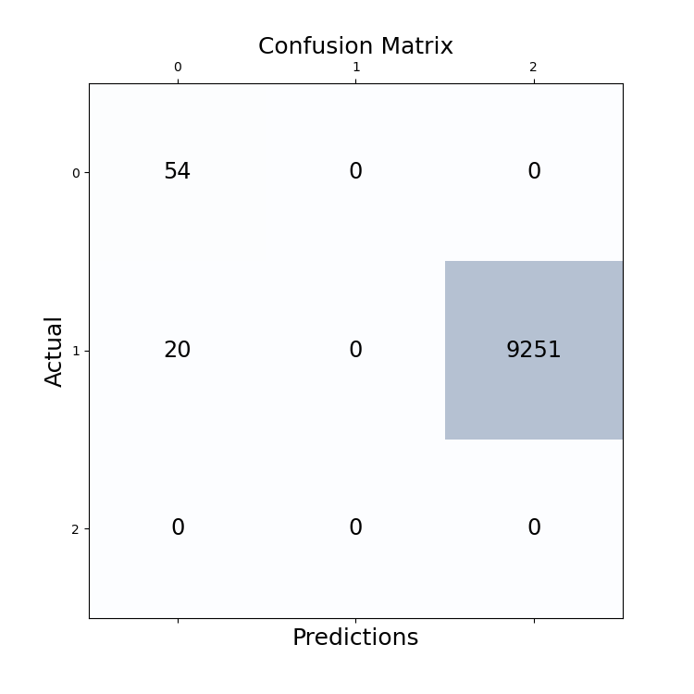
Results with New Data
anomaly
benign
precision recall f1-score support
-1 0.73 1.00 0.84 54
0 0.00 0.00 0.00 9271
1 0.00 0.00 0.00 0
Why does it work?
Why there are a few FP(20)?
How would it work with more storage types?
The predictions are currently 2 values, which makes the scores Boolean-like

Slide 18
Data Splitting Overview
Reminder about the evaluation settings we used.
All Data (100%)
Target Model Training Set (50%)
Attack Evaluation Set (25%)
Attack Crafting Samples Set (25%)
Train (95%)
Train (95%)
Randomly selected 1000 pairs
Test (5%)
Test (5%)

Slide 19
Target Models Structure
Reminder about the evaluation settings we used.
The predictor is a DNN model with the following structure:
Input: The substruction of the embedding vectors (512,1).
Inner structure:
Layer 1: 256 neurons with ReLU activation.
Layer 2: 128 neurons with ReLU activation.
Layer 3: 64 neurons with ReLU activation.
Layer 4: 32 neurons with ReLU activation.
Layer 5: 16 neurons with ReLU activation.
Layer 6: 8 neurons with ReLU activation.
Output layer: 1 neuron with Sigmoid activation.
Training parameters: Adam optimizer with 0.0001 as the learning rate, batch size of 64 and 30 epochs.

Slide 20
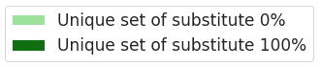
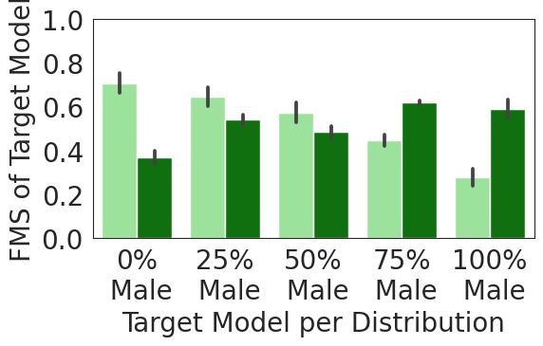
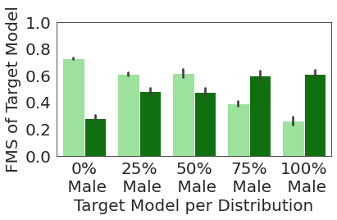
MIA Evaluation Metrics Results
The X-axis displays the five different property distributions on which each target model was trained.
Adversarial samples that mislead substitute 0%
and not substitute 100%
Explain exactly what we see.
Adversarial samples that mislead substitute 100%
and not substitute 0%
Don’t forget: the graph should be clear with axis titles.

Slide 21
MIA Evaluation Metrics Results
The table presents the attack results for the property “5OCS”.
Each row shows the attack results when performed on a different target model.
For example: the first row shows the results for a target model that was trained with 0% 5OCS in the training set i.e., not 5OCS.
Inferred property | MIT Gap (std) | Title | Other | Else | Something | Property Distribution | Backbone
No 5OCS | (0.0202) 0.2028 | (0.0200) 0.2252 | 0.4280 (0.0186) | 100% | 0% | 0% | iresnet100
No 5OCS | (0.0059) 0.1677 | (0.0127) 0.2920 | (0.0091) 0.4596 | 100% | 0% | 25% | iresnet100
No 5OCS | (0.0221) 0.0747 | (0.0107) 0.3717 | (0.0159) 0.4464 | 100% | 0% | 50% | iresnet100
5OCS | (0.0025) 0.0492- | 0.3824 (0.0123) | (0.0135) 0.3331 | 100% | 0% | 75% | iresnet100
5OCS | (0.0150) 0.1774- | 0.4209 (0.0106) | (0.0183) 0.2435 | 100% | 0% | 100% | iresnet100

Slide 22
MIA Evaluation Metrics Results
The first two columns show the experiments settings.
The used backbone.
The target model property distribution in the training set.
Inferred property | MIT Gap (std) | Title | Other | Else | Something | Property Distribution | Backbone
No 5OCS | (0.0202) 0.2028 | (0.0200) 0.2252 | 0.4280 (0.0186) | 100% | 0% | 0% | iresnet100
No 5OCS | (0.0059) 0.1677 | (0.0127) 0.2920 | (0.0091) 0.4596 | 100% | 0% | 25% | iresnet100
No 5OCS | (0.0221) 0.0747 | (0.0107) 0.3717 | (0.0159) 0.4464 | 100% | 0% | 50% | iresnet100
5OCS | (0.0025) 0.0492- | 0.3824 (0.0123) | (0.0135) 0.3331 | 100% | 0% | 75% | iresnet100
5OCS | (0.0150) 0.1774- | 0.4209 (0.0106) | (0.0183) 0.2435 | 100% | 0% | 100% | iresnet100

Slide 23
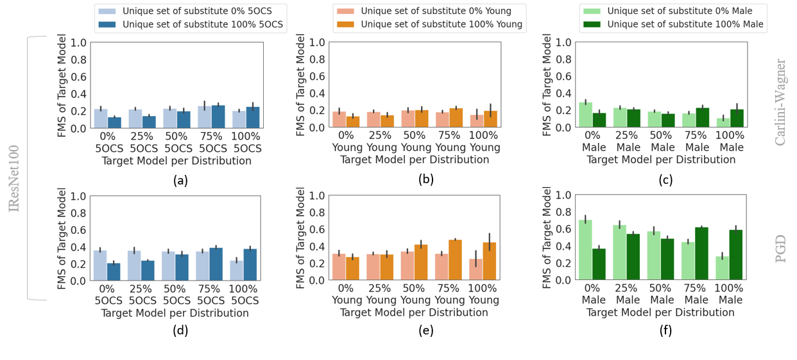
MIA Evaluation Metrics Results
We note that all the attacks successfully infer the ….
Except for the ….
Furthermore, the standard deviation values are less than 0.09, which indicates that the results are consistent.
5OCS
Young
Male
Explain what are the important things we can see when examining the results.

Slide 24
Results Discussion
If you have concerns/questions regarding the results we obtained, here is the place to ask.
I.e., after you reminded the metric and explained everything clearly about the obtained results.

Slide 25
Next Steps 26.09.2023
Expand the testing with another attack.
Find out the answers to the questions that arose during results review.
Add an encoded version of the permissions document of each role.
This could be a different approach that would involve vectors instead of forest.
A combination of those models might be more robust and adaptable.
Code changes in attacks, different DL from amir’s
Create anomaly sign in attributes.

Slide 26
Thank You

Slide 27
References
https://aws.amazon.com/guardduty/
Data Leakage Detection and Prevention: Review and Research Directions
More
More
More
More
More
More
More
More
More
More
More
More
Copy the APA cite from Google Scholar

